Slide 1
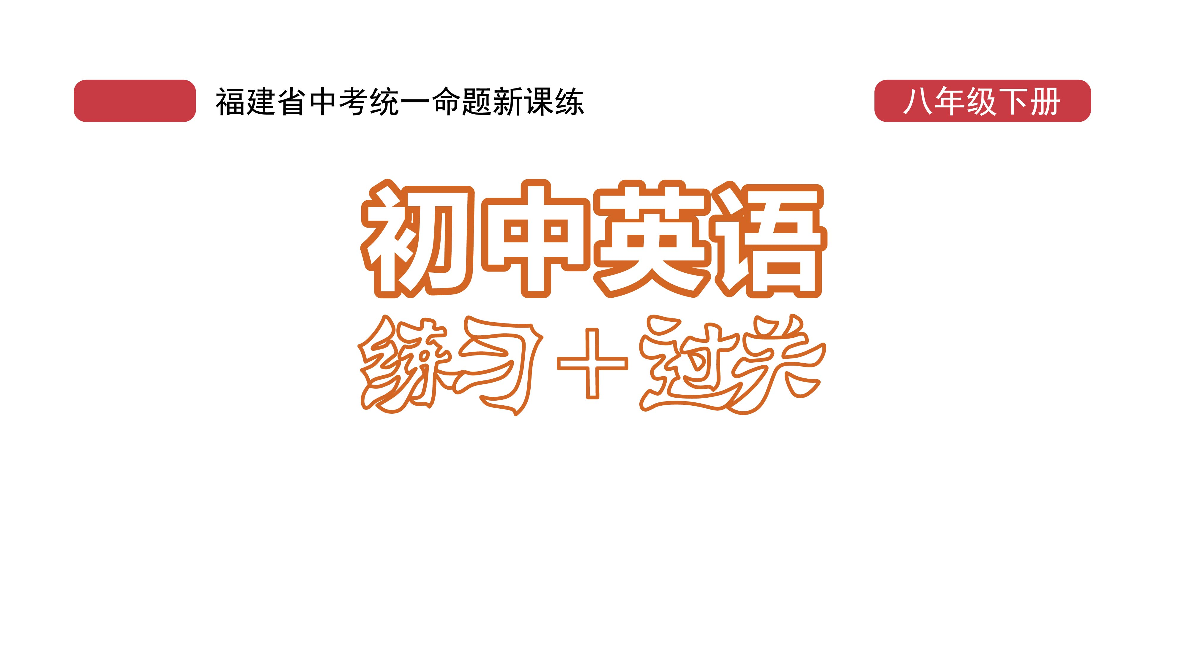
课时练习
期中复习六 模块六 第三章

Slide 2
一、根据语境、 音标或所给单词的提示完成句子， 每空一词。
1. It’s not easy having a friendship when you live at__________/ˈɒpəzɪt/ ends of the country.
2. The police were worried about the_______(safe) of the missing boy.
3. In cities, cars and buses can cause much air________.
opposite
safety
pollution

Slide 3
一、根据语境、 音标或所给单词的提示完成句子， 每空一词。
4. Many factories_________/ˈempti/ their waste(废料) into the river.
5. Fathers usually play a_________(center) role in the family.
empty
central

Slide 4
二、 重点句型。（根据中文提示完成句子， 每条横线不限词数。）
1.如果人们遵守交通规则， 交通事故就会减少。
If people__________________________________,
there will be ________________________________.
2. 骑自行车可以节约能源， 还不会造成空气污染。
Cycling can help us _____________________,
and it doesn’t __________________________.
obey the traffic rules
fewer accidents
save energy
cause air pollution

Slide 5
二、 重点句型。（根据中文提示完成句子， 每条横线不限词数。）
3. 如果我们违反交通规则， 我们会被罚款， 甚至处于危险之中。
If we ____________________, we may _____________ and even be____________.
break the traffic rules get a fine
in danger

Slide 6
二、 重点句型。
二、 重点句型。（根据中文提示完成句子， 每条横线不限词数。）
4. 所以骑自行车的人必须注意周围的交通情况， 同时要了解交通信号。
So bicycle riders must __________________the traffic around them and learn about _____________.
pay attention to
traffic signals

Slide 7
二、 重点句型。
二、 重点句型。（根据中文提示完成句子， 每条横线不限词数。）
5. 万一发生事故， 骑自行车的人应当知道如何进行急救。
__________________an accident, bicycle riders should know how _____________.
In case of
to give first aid

Slide 8
三、重点语法。
★if引导的条件状语从句
(A)根据所学知识， 将横线上的内容补充完整。
If引导的条件状语从句既可位于主句之前， 也可位于主句之后。位于主句之_____时， 常用逗号与主句隔开。当主句和从句都表示将要发生的动作时， 通常主句用__________时, 从句用__________时（即 “主将从现”）。如： If it’s fine tomorrow, we will go boating.=We will go boating if it’s fine tomorrow.
前
一般将来
一般现在

Slide 9
三、重点语法。
(B)根据中文提示完成句子。(每条横线不限词数。)
1. 如果明天下雨， 我们就不去野营。
We _______go camping_______________ tomorrow.
2. 如果没有水， 我们就无法生存。
We can’t live _________________________________.
won’t if it rains
if there is no water

Slide 10
三、重点语法。
(B)根据中文提示完成句子。(每条横线不限词数。)
3. 如果我有台电脑， 我就会在互联网上学习。
_____________________ , I’ll study on the Internet.
4. 如果你上学迟到， 老师会很生气。
If you _________________ , the teacher____________.
If I have a computer
are late for school will be angry

Slide 11
四、单项选择。
( )1. ___________the hard work of the scientists, it’s not possible for the three men to travel into space.
A. With B. Without C. No
B

Slide 12
四、单项选择。
( )2. Students should_______what their teacher says in class.
A. keep away from B. take care of
C. pay attention to
C

Slide 13
四、单项选择。
( )3. Beijing is________the northeast of China and Japan is______the east of China.
A. in; in B. in; to C. to; in
B

Slide 14
四、单项选择。
( )4. Car drivers must________when they pass schools to avoid（避免） accidents.
A. slow down B. put down C. look down
A

Slide 15
四、单项选择。
( )5. If I___________tomorrow, I’ll pay a visit to Fuzhou National Forest Park.
A. has time B. will have time
C. have time
C

Slide 16
四、单项选择。
( )6. —Shall we go boating, Tina?
—Are you______? The highest temperature is only 4℃ today.
A. careless B. crazy C. ready.
B

Slide 17
四、单项选择。
( )7. —Cats are the cutest animals of all________.
—________. Dogs are much cuter.
A. I agree with you
B. I disagree with you
C. I’d love to
B

Slide 18
四、单项选择。
( )8. Though it was late at night, my father still ______working on the computer.
A. went on
B. put on
C. tried on
A

Slide 19
四、单项选择。
( )9. —________! A car is coming!
—Uh-oh! How dangerous! It almost hit me.
A. Look at B. Look out C. Look after
B

Slide 20
四、单项选择。
( )10. —I heard that over 300 people lost their life in the 7.20 Henan rainstorm.
—______________________.
A. I think so.
B. I’m sorry to hear that.
C. That’s all right.
B

Slide 21

五、看图写话。
1. among
Jessica is the shortest among the three girls.

Slide 22
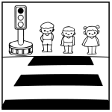
五、看图写话。
2. should, rule，when
People/They should obey the traffic rules when crossing the road.

Slide 23
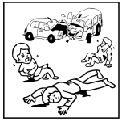
五、看图写话。
3. be hurt
Some people/They were hurt in the traffic accident.

Slide 24
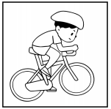
五、看图写话。
4. good, environment
Bicycle riding/Cycling is good for the environment.

Slide 25
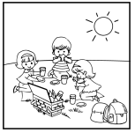
五、看图写话。
5. if, tomorrow
If it’s fine tomorrow, they will go for a picnic./
The kids will have a picnic if it’s fine tomorrow.

Slide 26
六、情景交际。
1. 朋友生病打电话向你求助， 你想建议他立刻打120， 可以这样说：
_________________________________________.
2. 你想提醒爸爸开车时要注意周围的交通， 可以这样说：
Dad, you should _______________________________ when driving.
3. 你想知道外公去钓鱼的频率， 可以这样问：
Grandpa, _________________________________?
You should call 120 at once
pay attention to the traffic around you
how often do you go fishing

Slide 27
六、情景交际。
4. 你想告诉弟弟如果认真就能通过考试， 可以这样说：
If ____________________________________________.
5. 购物结束你想建议妈妈一起打车回家， 可以这样说：
______________________________________________________________________________________________?
you are careful (enough), you’ll pass the exam
How about going home by taxi/ How about taking a taxi home

Slide 28
七、短文填空。
One day when Juanita was playing in the attic(阁楼), she saw a box in the 1 /ˈkɔːnə(r)/. Juanita brought 2 box over to the middle of the attic to see it more clearly. She opened it 3 (careful) and looked inside. Inside the box were some black and white photos. Most of them were of a small girl in a white dress. Her hair was braided(被编成辫). There was a farmhouse 4 each picture. In one photo
corner
the
carefully
in

Slide 29
七、短文填空。
there was even a horse. Juanita was very 5_________ /səˈpraɪzd/. The girl looked just like her! This was confusing (令人费解的). “I’ve never been to that house,” she thought when she was 6 (look) through the photos.
Then she went to her mom with those photos. “When did we visit a farm? And when did you braid my
surprised
looking

Slide 30
七、短文填空。
hair? And why don’t these pictures have any color?” Juanita asked a lot of 7 (question).
Mom laughed, “Oh, these are photos of your grandmother 8 she was a little girl. This was the farm where she lived in Mexico.”
“Wow!” said Juanita. “I guess I 9 /ˈriːəli/ look like her!” She laughed, too.
questions
when
really

Slide 31
七、短文填空。
“We shouldn’t keep these up in the attic,” said Mom. “Let’s hang(悬挂) them up in your room.”
Juanita 10 (smile). “I’d like that,” she said.
smiled

Slide 32
八、阅读理解。
British roads are some of the safest in the world. A study found that 3.8 people per 100,000 died in traffic accidents in the UK. 1 So, what are British drivers doing differently? Here are some tips for drivers who are planning a trip to the UK.

Slide 33
九、阅读理解。
2 In fact, a long time ago people drove on the left in most countries, but now only a few countries do like this. Don’t forget that this also means you must drive the other way around roundabouts(环岛).
3 If you are in a queue(行列) of traffic, then don’t try to push past the cars in front of yours. This is called “jumping the queue”. You must wait for your turn, or people may get angry with you.

Slide 34
九、阅读理解。
You must stop at the traffic lights when they are red. In many countries, it is OK to go past the red lights if you are turning a corner and there isn’t any other traffic around. 4___
If you get in an accident, don’t try to pay the police. 5 If you try to give them some, you could end your holiday visiting a British prison(监狱).

Slide 35
九、阅读理解。
A. The police in the UK never take money.
B. British people feel that waiting is a must.
C. This number was lower than any other country.
D. People in Britain drive on the left side of the road.
E. In the UK， however， you could have a lot of trouble if you do this.
1. _____ 2. _____ 3. _____ 4. _____ 5. _____
C D B E A

Slide 36


